Slide 1



Ask Your Doctor
Presented By
Virbhadra Biradar & Dinesh Wadikar

Slide 2
Introduction
Your web application, "Ask Your Doctor," sounds like a valuable and convenient solution for individuals who are concerned about accessing medical care when traveling or relocating. By providing a platform to book appointments online with specialists in the user's locality, you're addressing a common worry and making healthcare more accessible. The ability to search for doctors based on specialties and location, along with the ease of booking appointments, could indeed bridge the gap between patients and doctors.
The emphasis on error-free, secure, reliable, and fast performance is crucial, especially in a healthcare-related application where accuracy and trust are paramount. In addition, the fact that your application requires only a web browser and an internet connection makes it accessible to a wide range of users.
The inspiration for your project, which came from the challenges posed by the post-pandemic situation, shows that you're attuned to real-world issues and are aiming to contribute positively to the healthcare landscape. Offering a platform that not only aids patients but also helps streamline the process for doctors and saves time for both parties is a commendable goal.
When developing and promoting your web application, it's important to pay attention to factors like user experience, data security, and user privacy. Since healthcare involves sensitive information, ensure that your application complies with relevant regulations and follows best practices for handling personal health data.

Slide 3
Technology Used
We used Java Spring-Boot as backend and React JS as Frontend in our Project.
Spring-Boot :– The primary objective of the Spring Boot framework is to minimize development time while enhancing efficiency. React has emerged as the preferred choice for front-end development due to its provision of a virtual browser environment, which is more user-friendly than a physical browser. Moreover, JavaScript developers can quickly transition into productive developers within a short span, thanks to the framework's concise API, a handful of functions, and their practical applications.
React :– React enables developers to build expansive web applications capable of modifying data without requiring a page reload. Its core objectives are speed, scalability, and simplicity. This sets it apart from Spring.

Slide 4
Application Functions
01
Online Appointment Booking: Users can easily find and book appointments with specialized doctors in their local area through the application.
Specialist Search: The application offers a search feature to help users find doctors based on their medical specialties and expertise.
02
Location-Based Services: Users can search for doctors within their geographical area, ensuring convenience and proximity to their current location.
03
Time Slot Selection: The application allows users to choose suitable time slots for their appointments, optimizing flexibility and convenience.
04
05
Accessibility: The platform is accessible through any web browser with an internet connection, enabling users to consult doctors anytime and anywhere.

Slide 5
Application Provide Modules
Ask Your Doctor" Web Application's functionalities align with CRUD operations
Create: Ask Your Doctor: Users can create new appointments by selecting doctors based on specialties and locations, then booking suitable time slots for consultation.
Read: Ask Your Doctor: Users can access their appointment history, reviewing past appointments and medical advice received from doctors.
Update: Ask Your Doctor: Users can modify appointment details, such as rescheduling or canceling appointments before the scheduled time.
Delete: Ask Your Doctor: Users can cancel appointments before the scheduled time, allowing for effective management of both doctors' and patients' schedules.

Slide 6
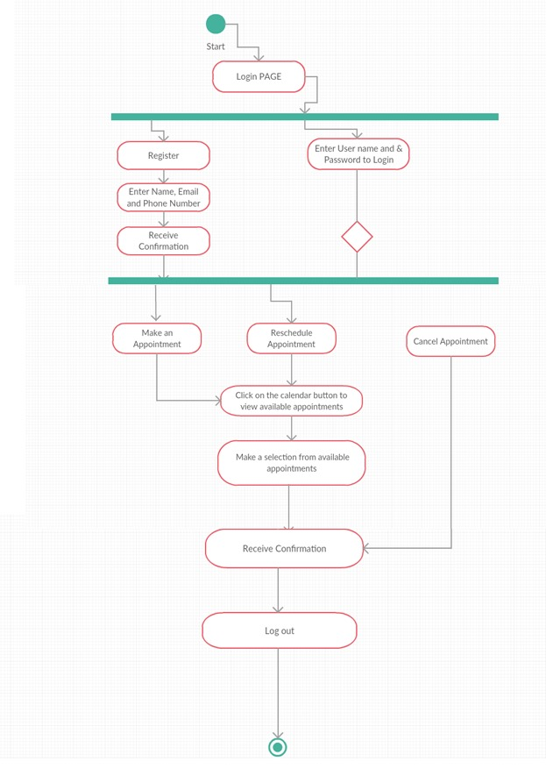
Application Activity Diagram

Slide 7
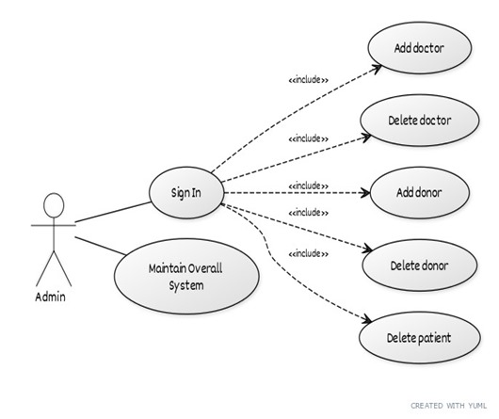
Admin side use case Diagram

Slide 8
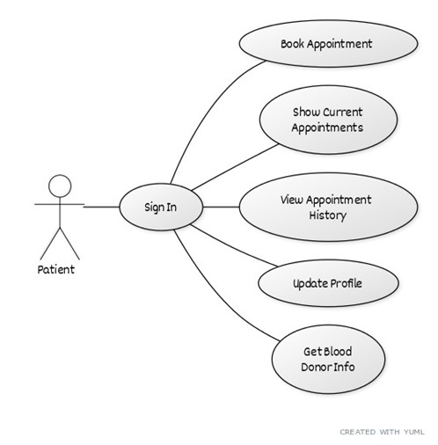
Patient side use case Diagram

Slide 9
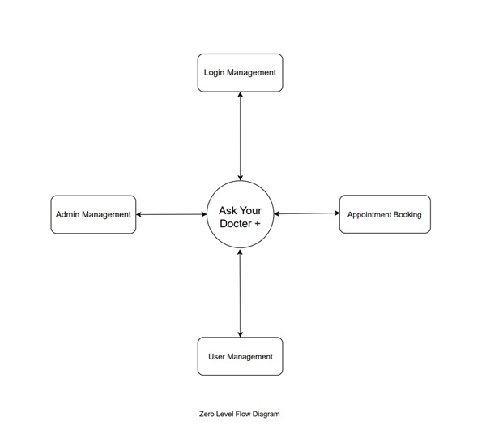
Zero Level Data Flow Diagram

Slide 10
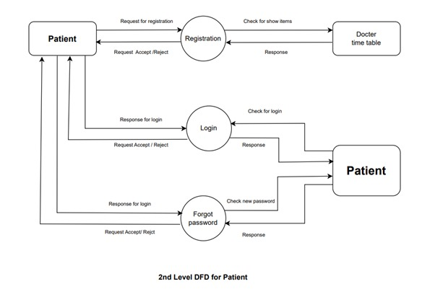
1st Level Data Flow Diagram

Slide 11
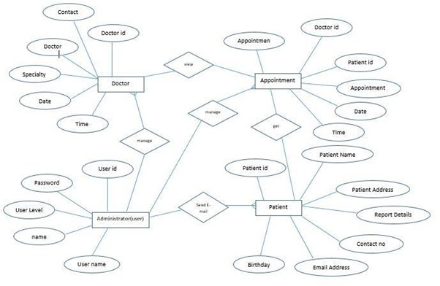
Entity Relationship Diagram

Slide 12
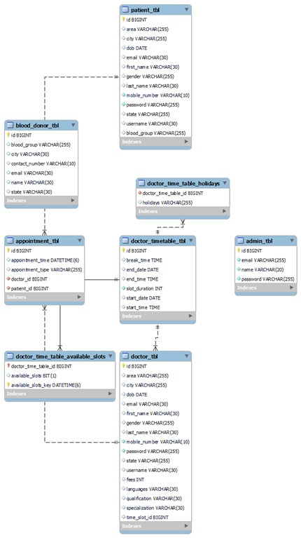
Class Diagram

Slide 13
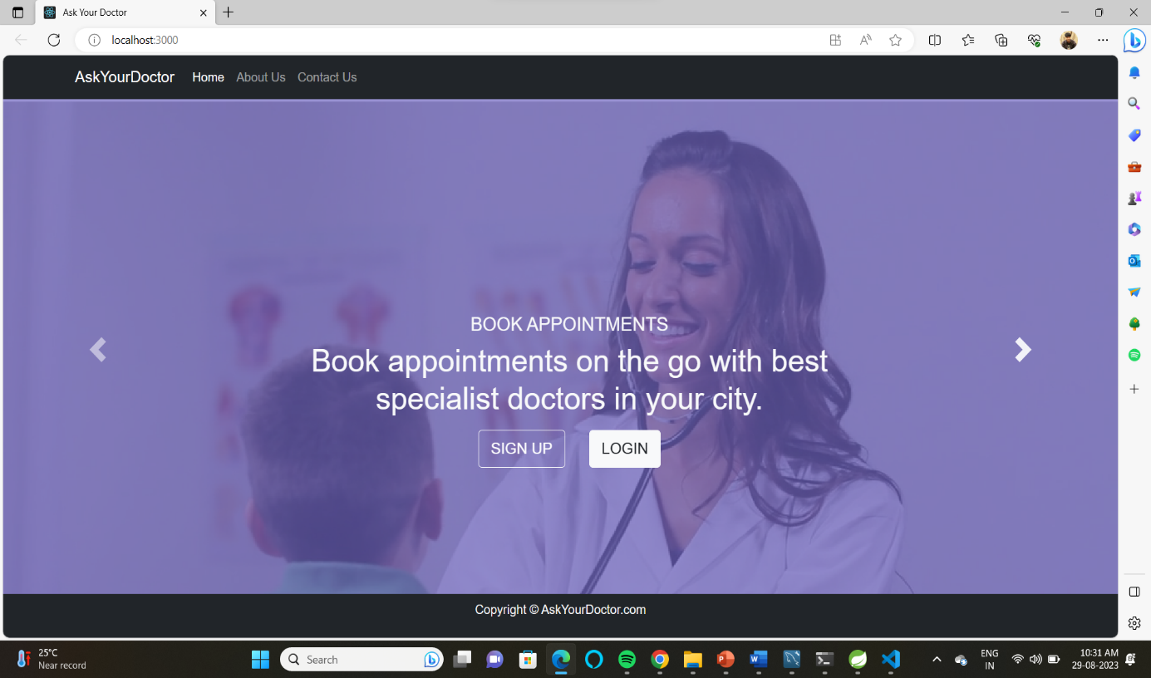

Slide 14
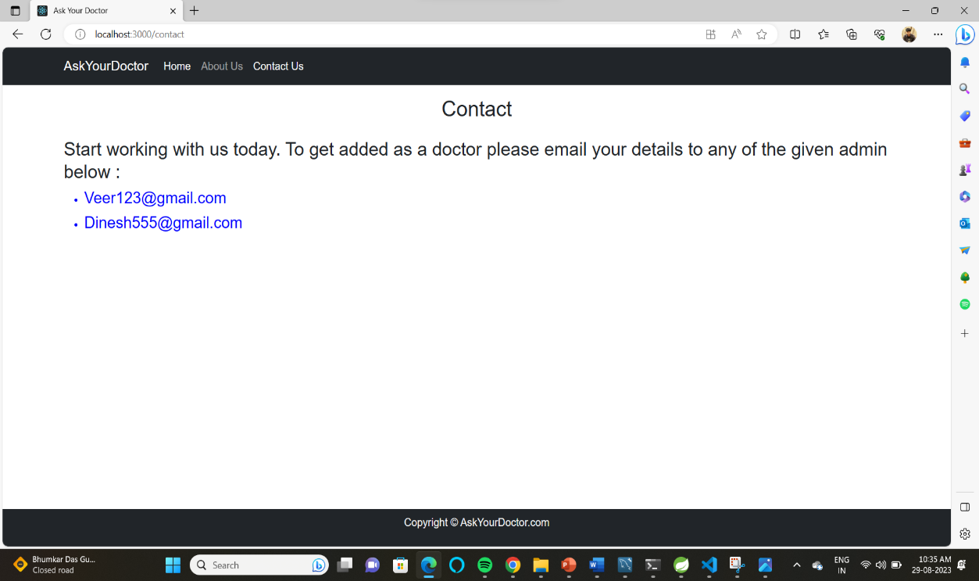

Slide 15
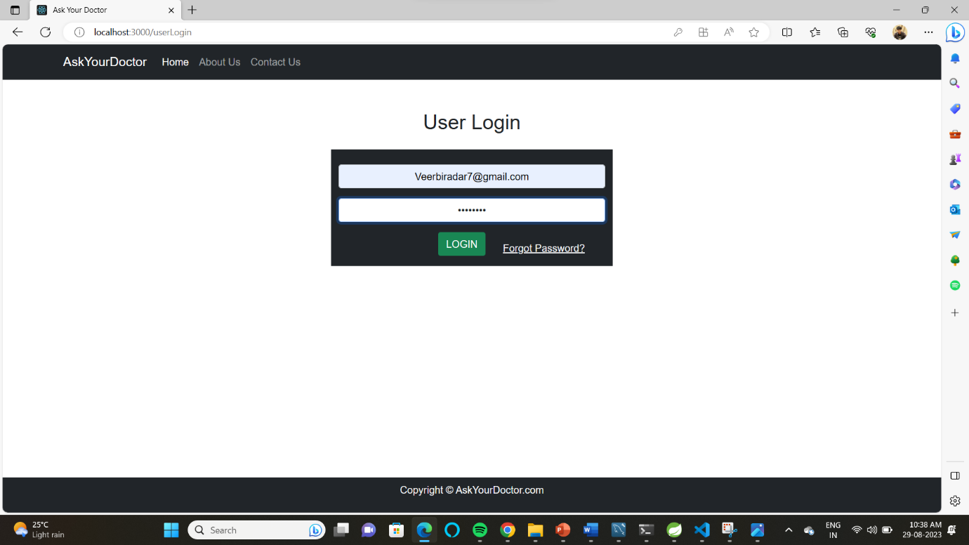

Slide 16
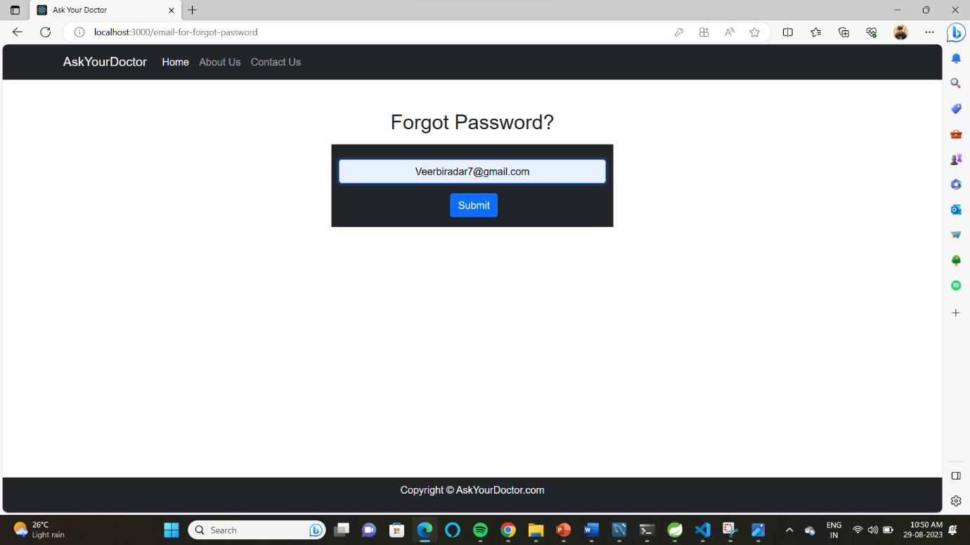

Slide 17
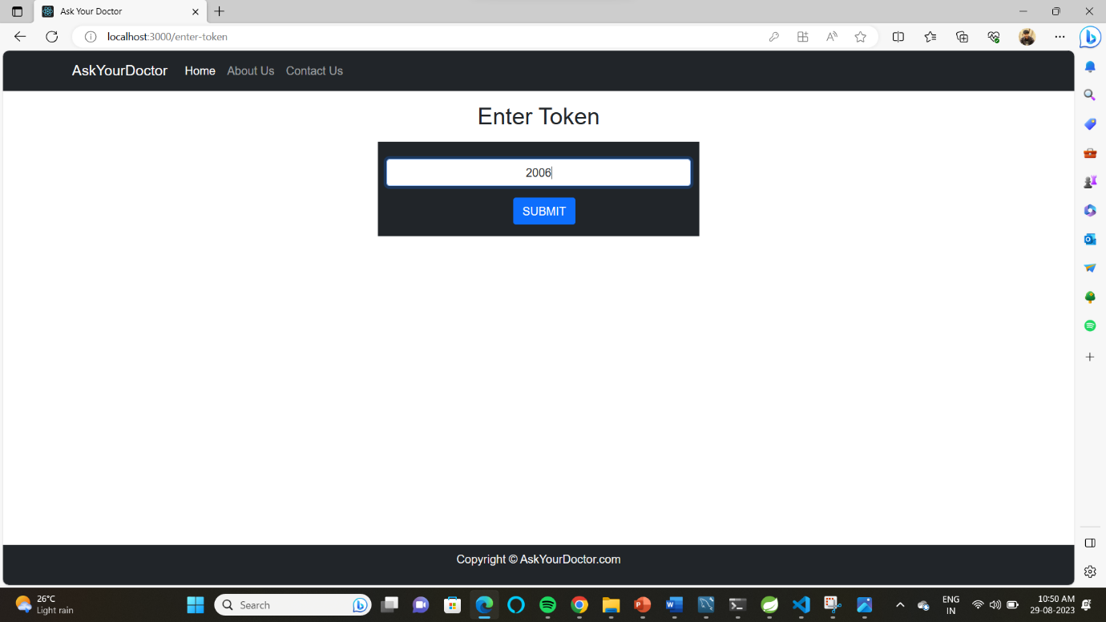

Slide 18
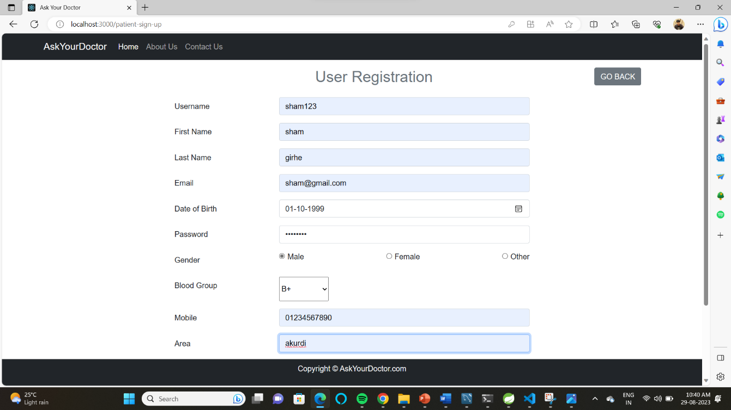

Slide 19
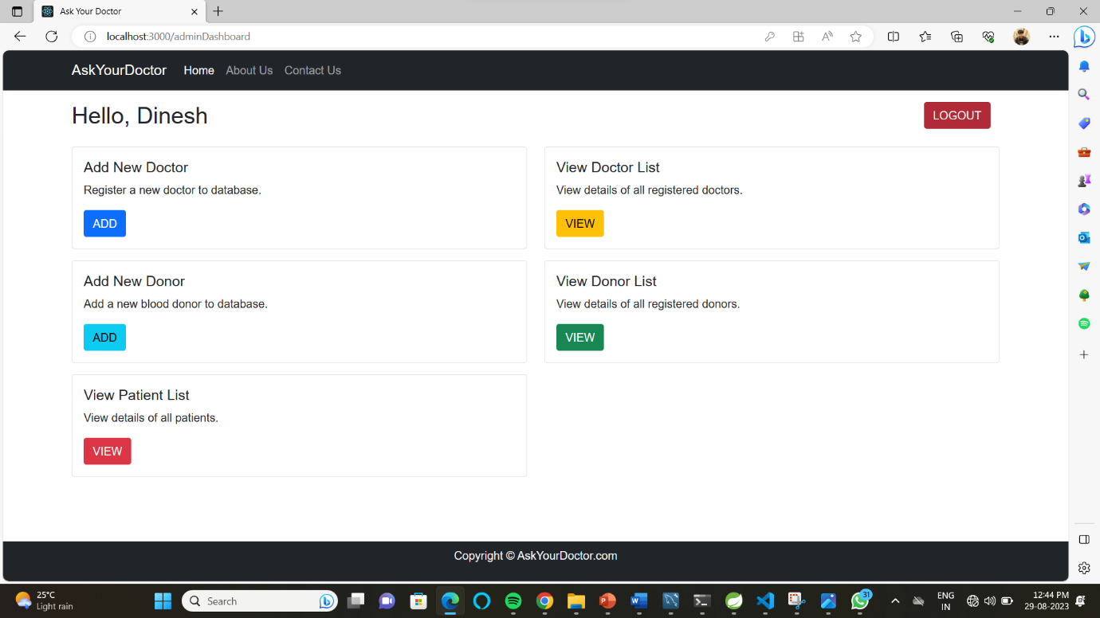

Slide 20
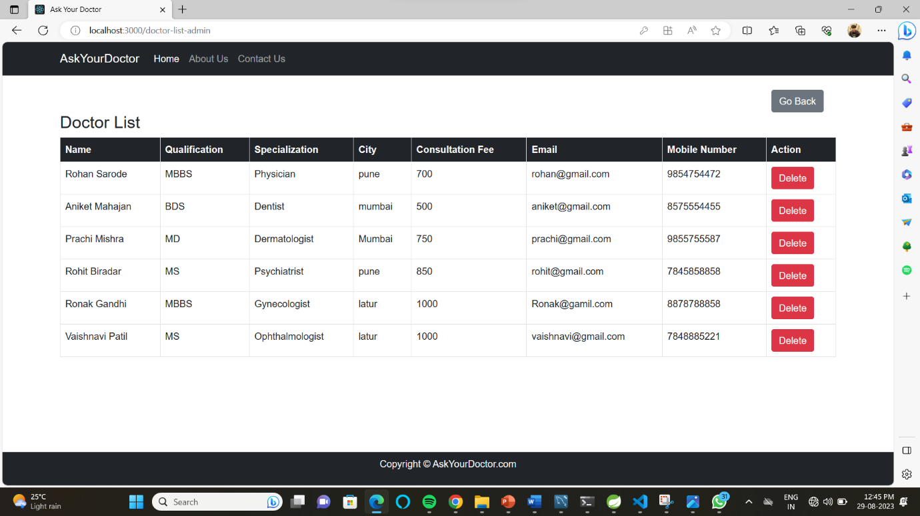

Slide 21
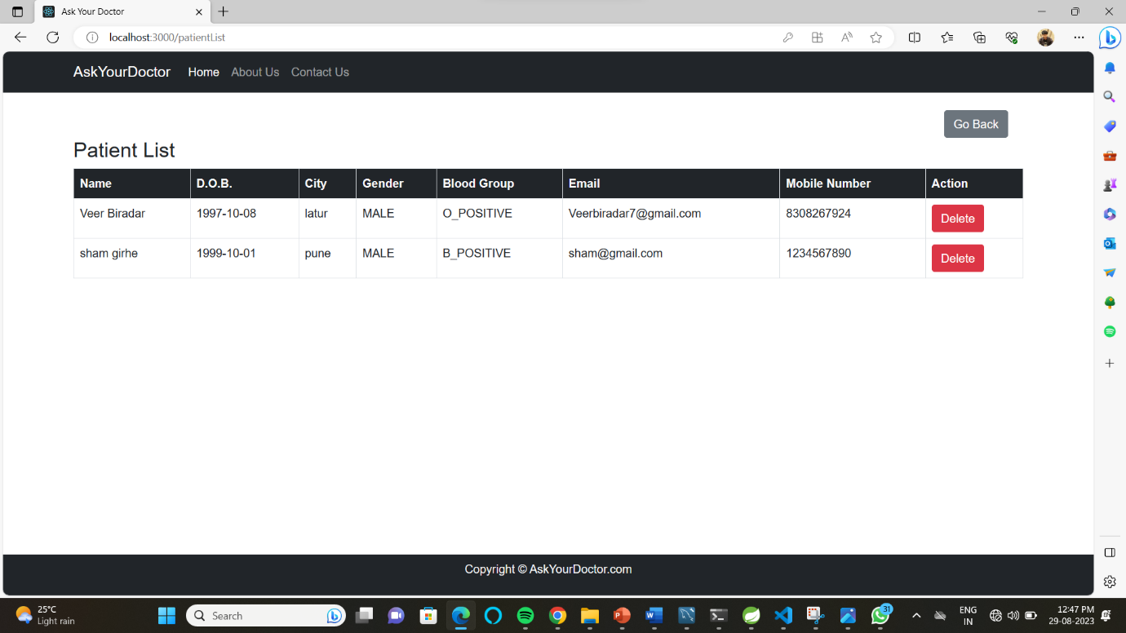

Slide 22
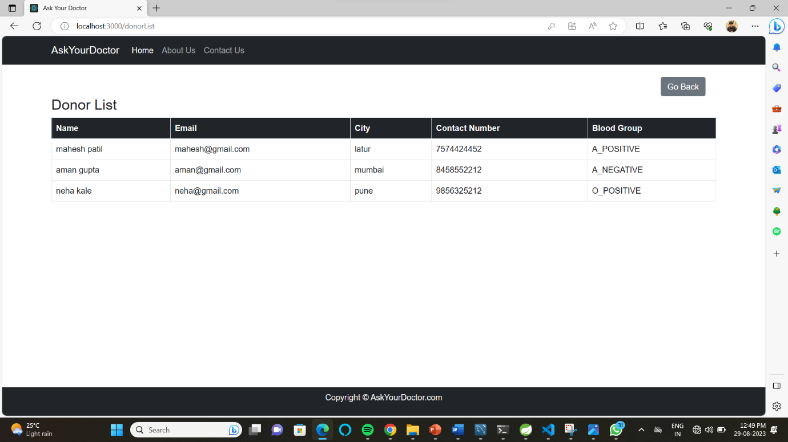

Slide 23
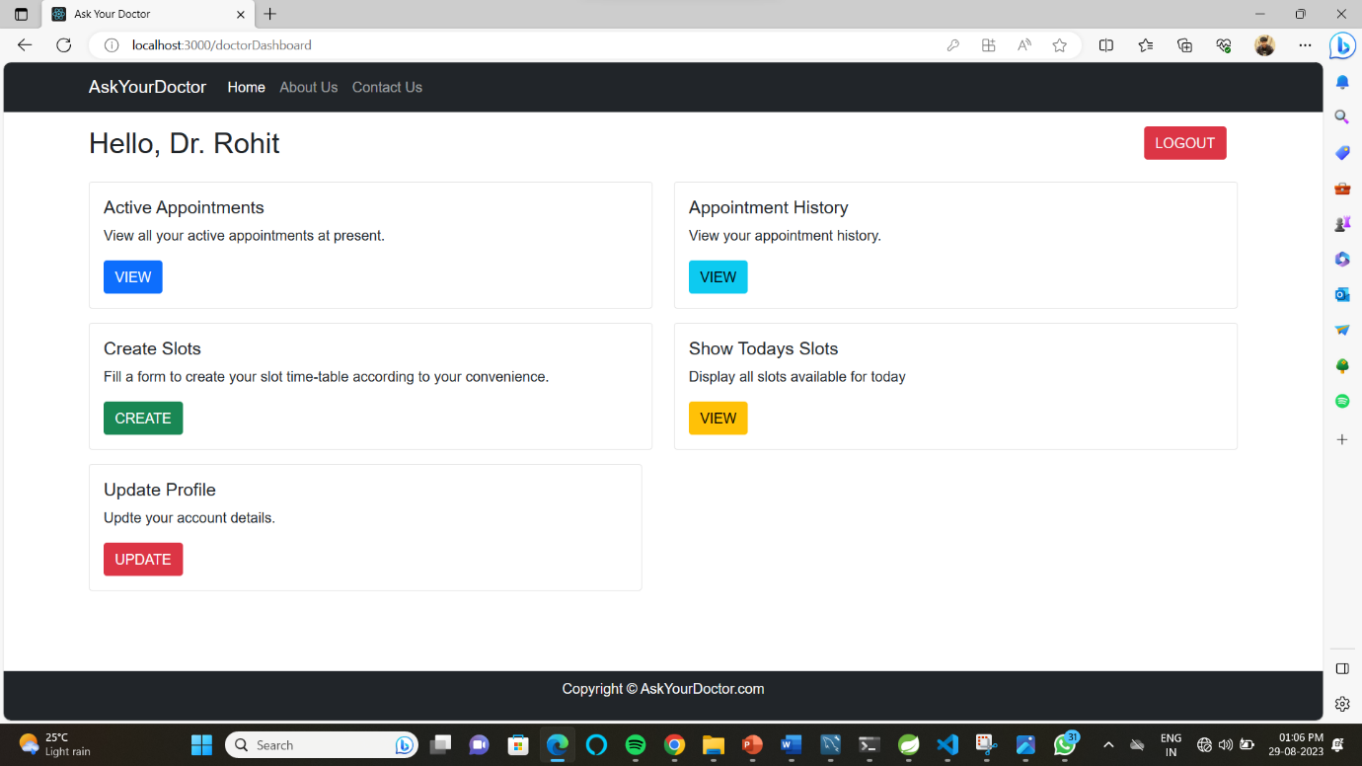

Slide 24
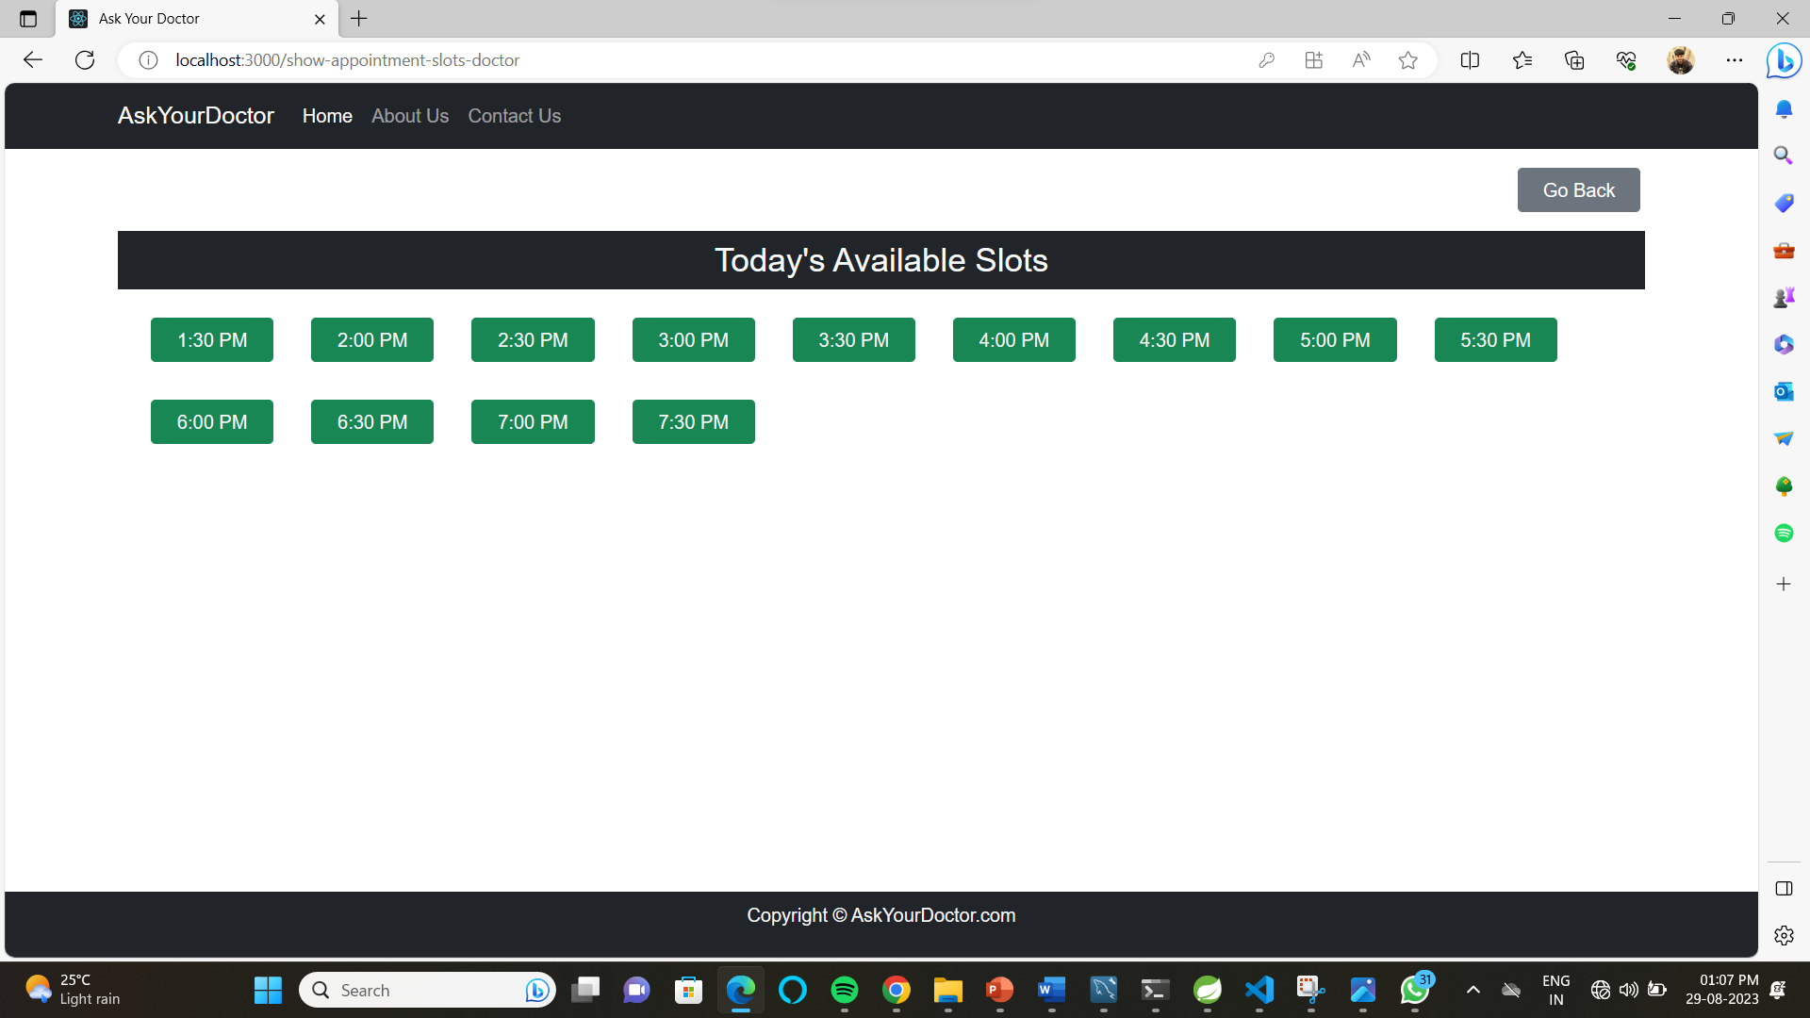

Slide 25
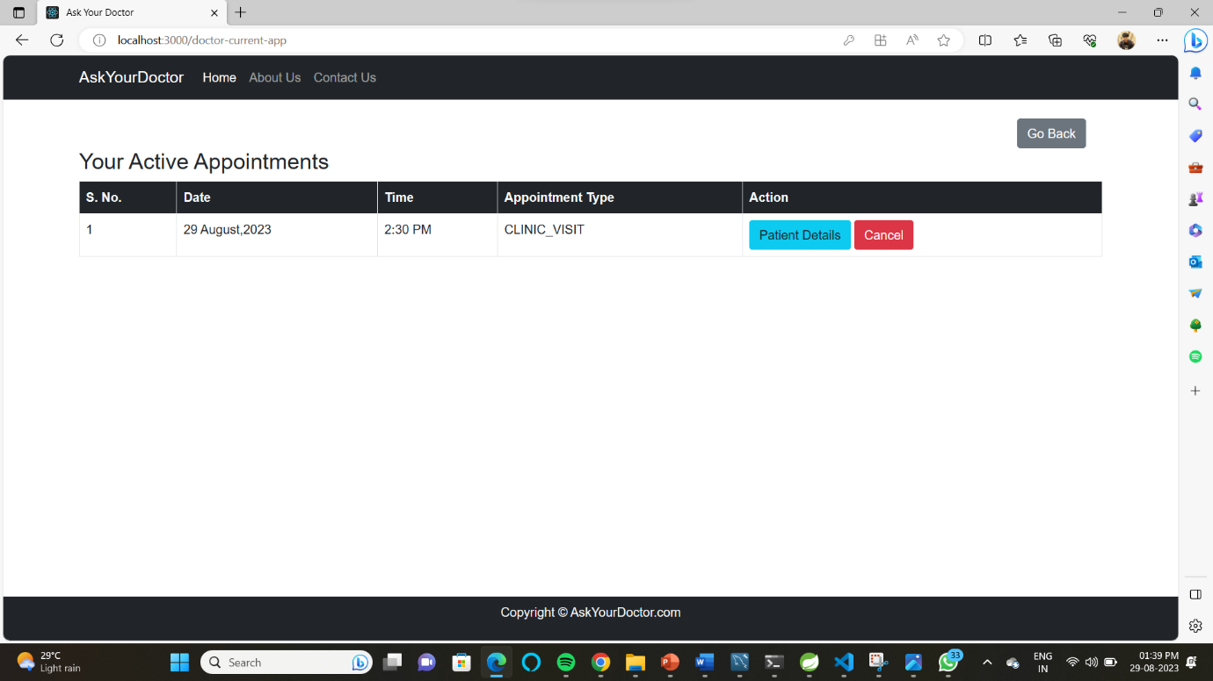

Slide 26
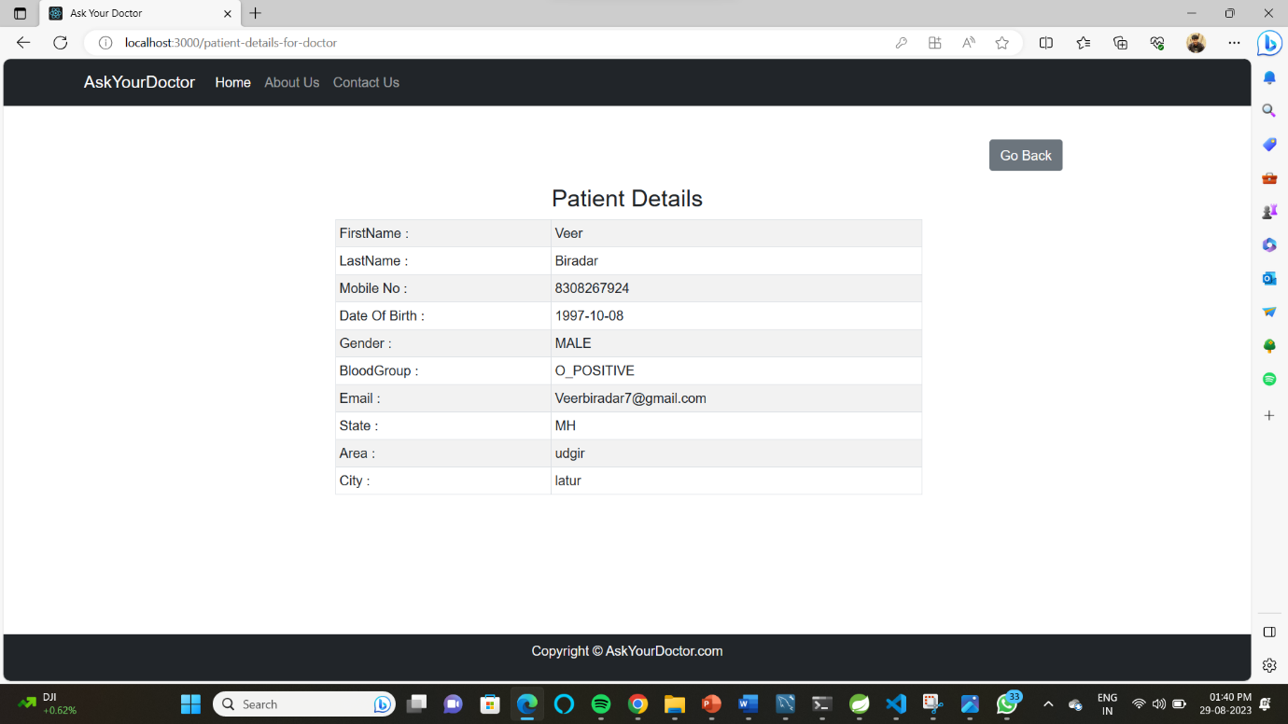

Slide 27
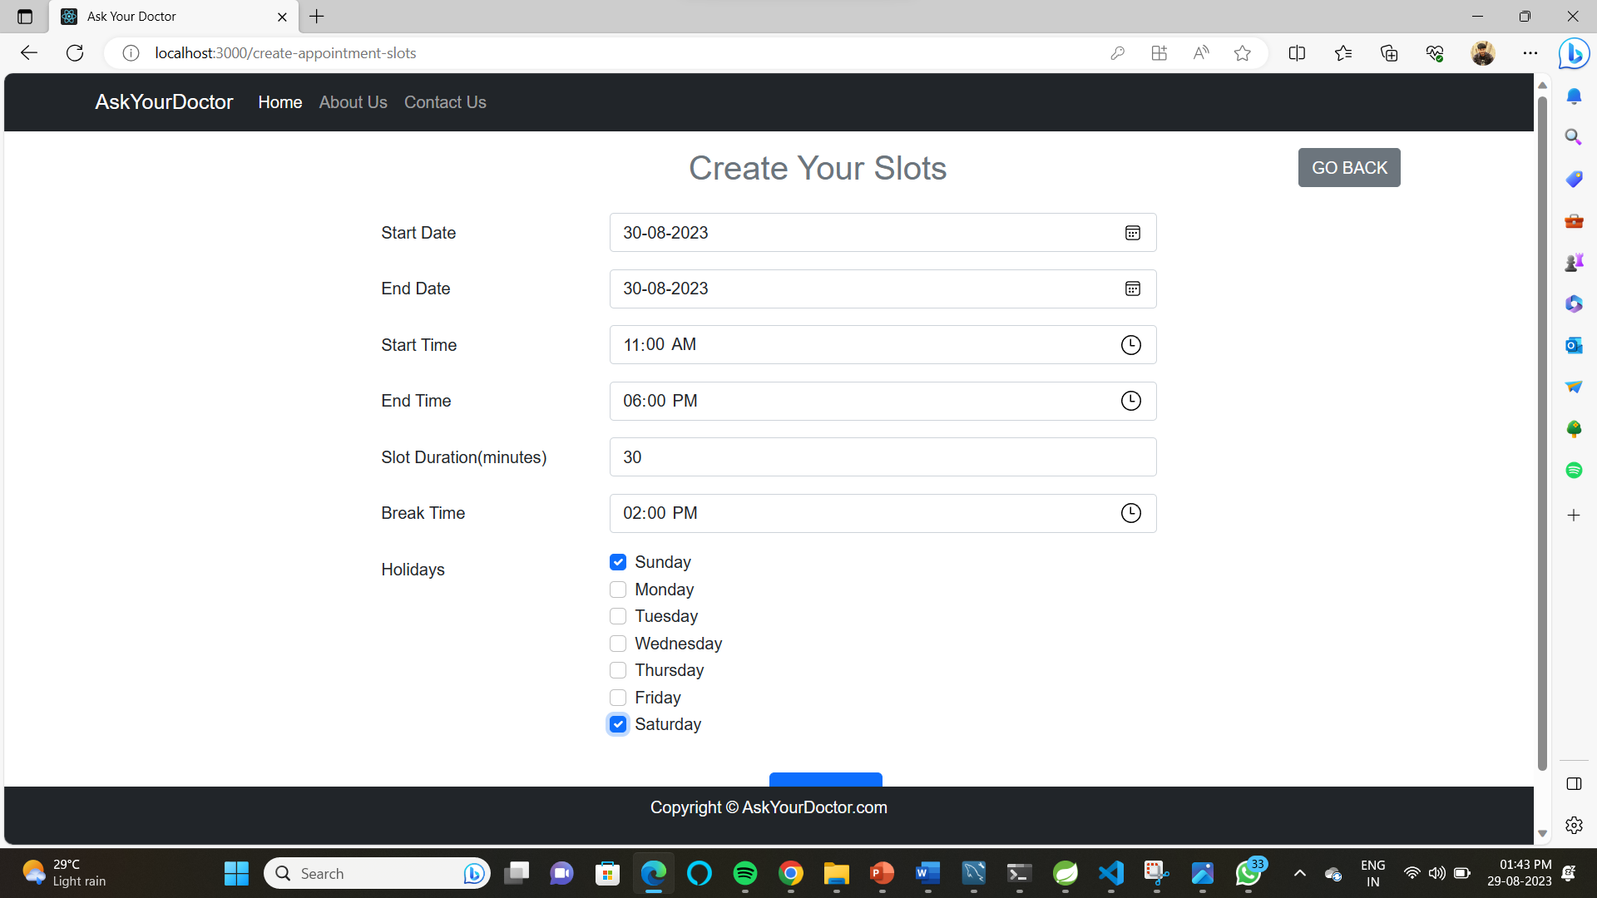

Slide 28
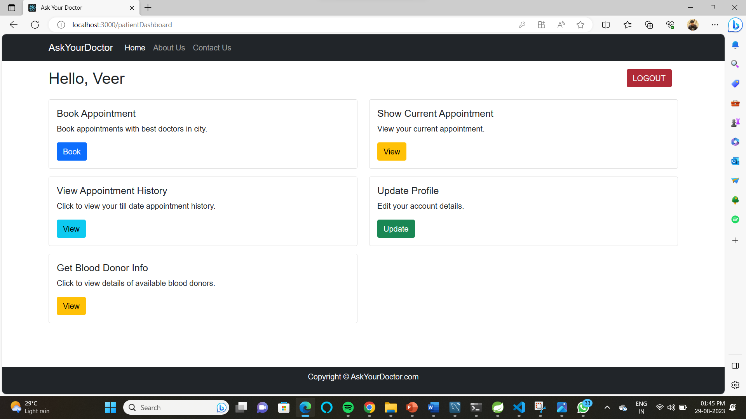

Slide 29
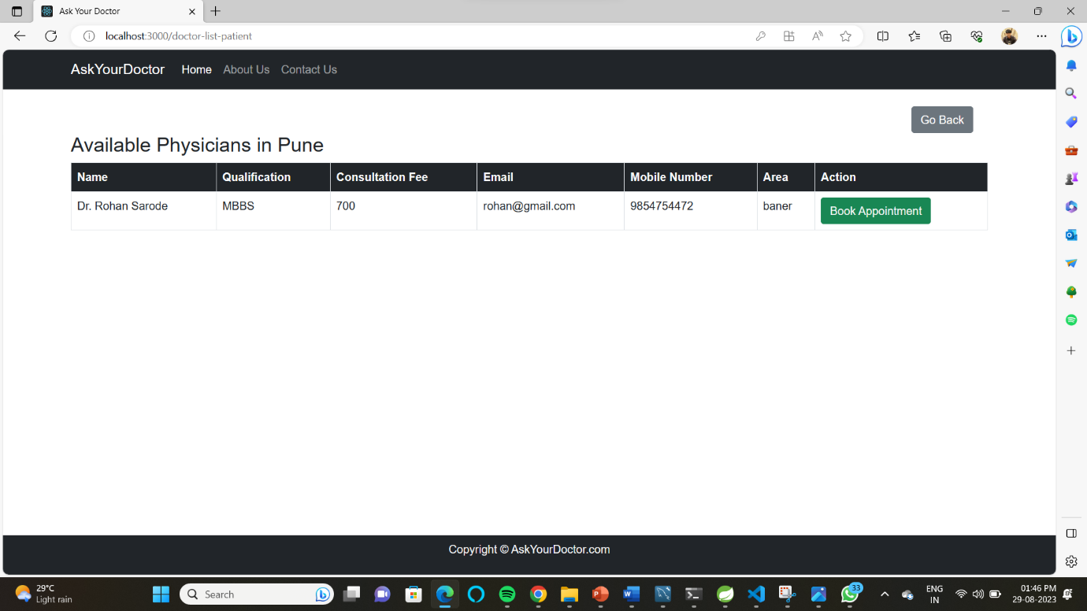

Slide 30
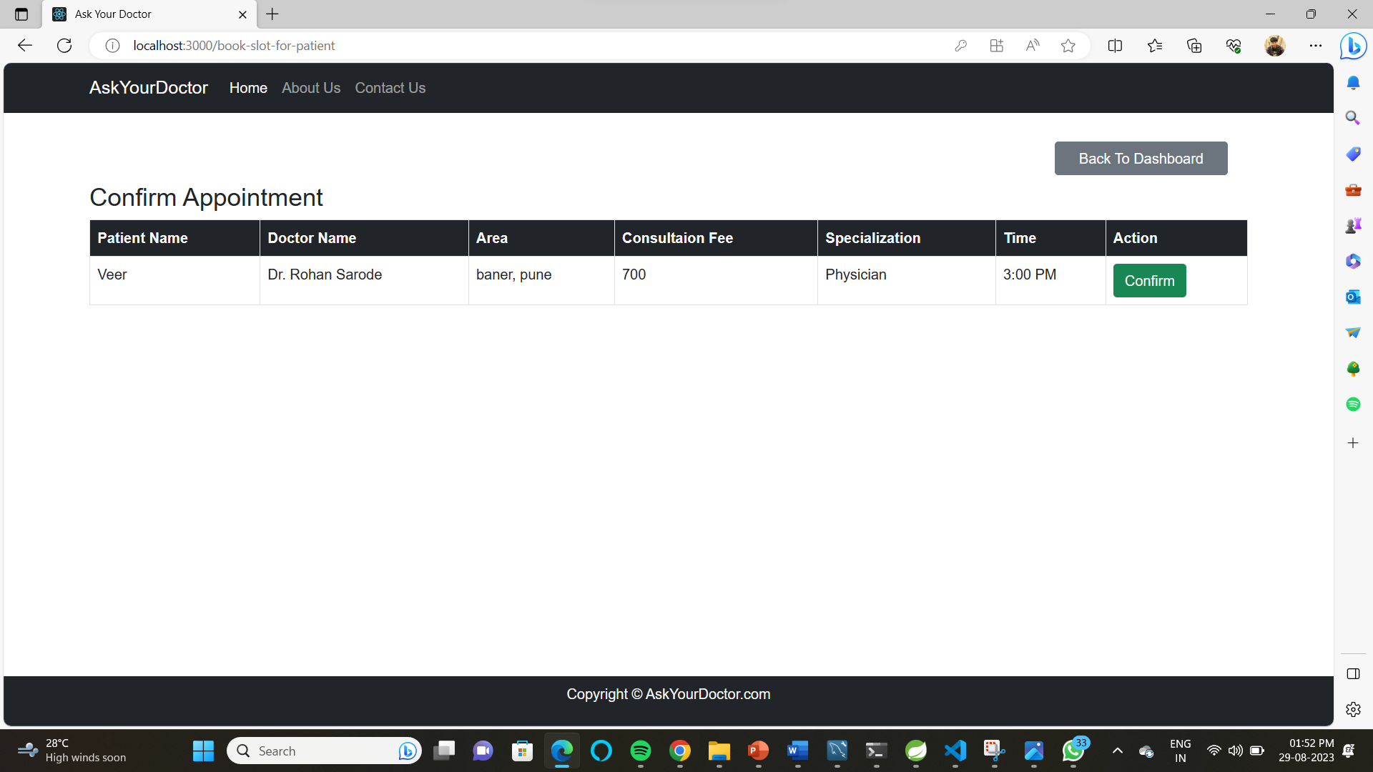

Slide 31
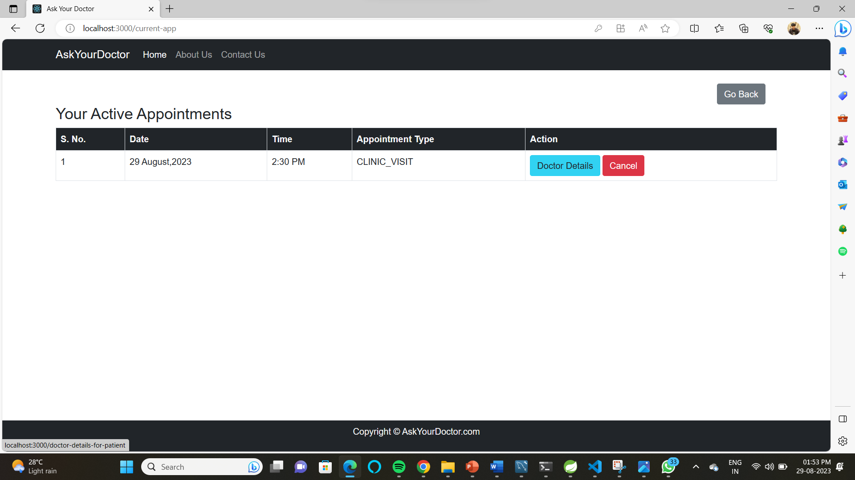

Slide 32
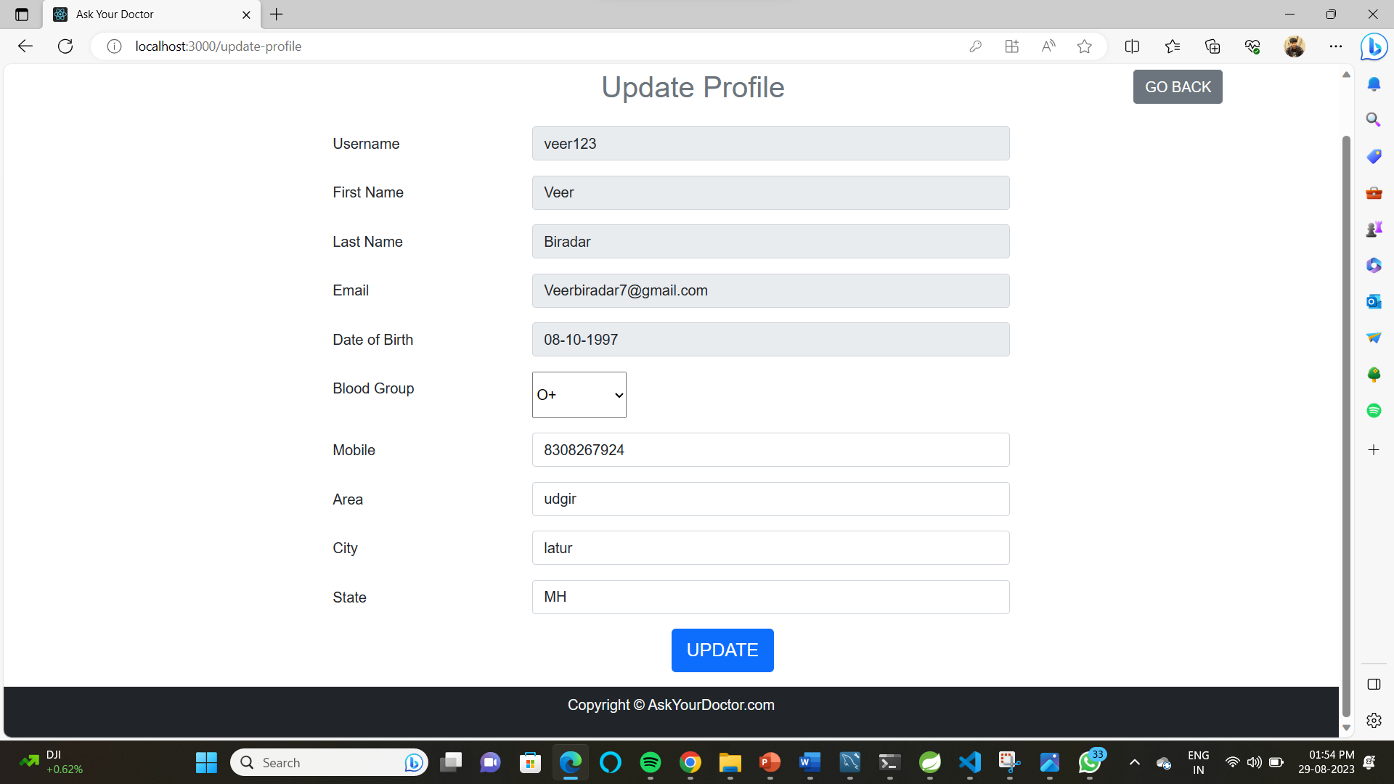

Slide 34
